Slide 1
Chapter Six*
Files and Exceptions
*Based on Starting Out with Python by Tony Gaddis

Slide 2
Chapter Six – Files and Exceptions
6.1 Introduction to File Input and Output
6.2 Using Loops to Process Files
6.3 Processing Records
6.4 Exceptions

Slide 3
6.1 Introduction to Files and Outputs
The programs we have used so far require input from the screen which has to be reentered each time because it is stored in RAM
Output from programs so far has been to the screen which disappears as soon as the shell is closed
In order to retain data for later use, it must be written to a file which is stored on a non-volatile medium such as a hard drive
Data that is written to a file can be re-used later by the same or another program

Slide 4
6.1 Introduction to Files and Outputs
Most commercial software packages store data in files:
Word Processors
Image Editors
Spreadsheets
Games
Web browsers
Business applications such as payroll programs

Slide 5
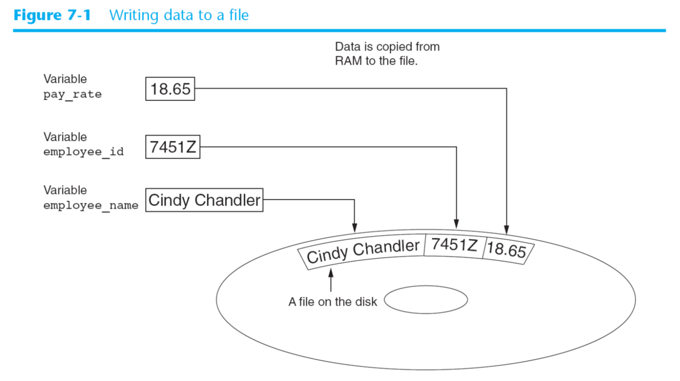
6.1 Introduction to Files and Outputs
Saving data in a file is called “writing to” a file
A piece of data is copied from RAM to the file
The file being written to is called an output file

Slide 6
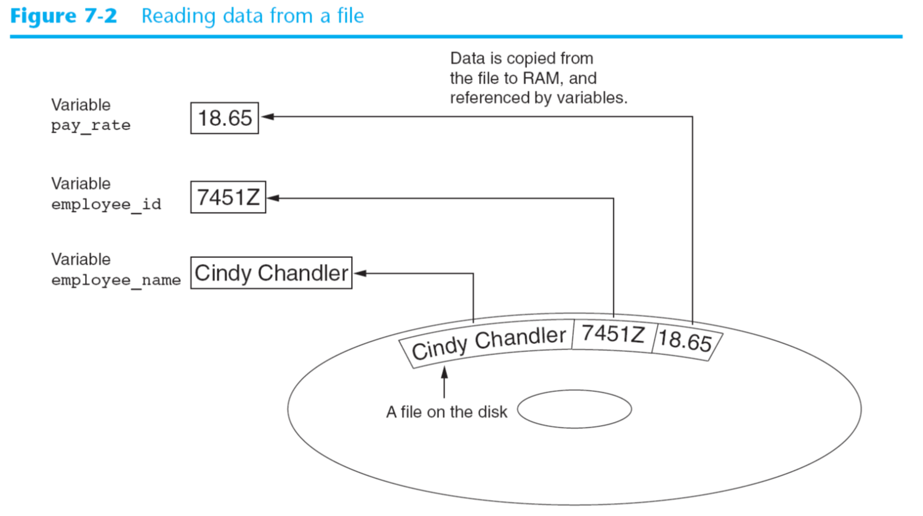
6.1 Introduction to Files and Outputs
Retrieving data from a file is called “reading data from” a file
A piece of data is copied from the file to RAM and referenced by a variable
The file being read from is called an input file

Slide 7
6.1 Introduction to Files and Outputs
This chapter is about writing to and reading from files
When dealing with files three things must occur:
Open the file – this creates a connection between the file and the program
Process the file – data is written to or read from the file
Close the file – when the program is finished with the file the file must be closed to disconnect it from the program

Slide 8
Types of Files
Text files – contains data encoded as text using a coding scheme such as ASCII or Unicode. Even numbers are stored in character format. This type of file may be opened by a text editor such as Notepad.
Binary files – contains data that has not been converted to text. This data is intended only for a program to read. This data cannot be viewed with a text editor.
We will only be working with text files so that we can create input and inspect output in Notepad.

Slide 9
File Access Methods
Two primary ways that programs access data stored in a file:
Sequential access – accessed from beginning to end. If you want to read a piece of data in the middle of the file you have to read all of the data that comes before it. You cannot jump directly to that piece of data. (Like a VCR tape)
Direct access (random access) – you can directly access any piece of data in the file by jumping directly to it. (Like a CD or MP3 player).
We will be using sequential access file access because it is simpler and will allow a basic understanding of file operations.

Slide 10
Filenames
Each operating system has its own rules for naming files
The files above are files that might be seen using Windows Explorer and the Windows Operating System
Filename Extensions are the three characters following the filenames above and usually indicate the type of file. (jpg is a graphic file, txt is a text file, doc is a Word file)

Slide 11
File Objects
When a program works with a file on disk, the program must create a file object in memory
A file object is an object that is associated with a specific file and provides a way for the program to link to the file through a variable.

Slide 12
Opening a File
The open function creates a file object and associates it with a file on the disk.
General format:
file_variable = open (filename, mode)
file_variable is the name of the variable that will reference the file object
filename is a string specifying the name of the file
mode is a string specifying the mode (read, write, etc.) in which the file will be opened

Slide 13
Opening a File

Slide 14
Opening a File
Examples:
To open a customer file for reading:
customer_file = open (‘customers.txt’, ‘r’)
Will open an existing file named customers.txt and reference the file object through the variable customer_file
To write to the sales file:
sales_file = open (‘sales.txt’, ‘w’)
Will create a new file called sales.txt and allow writing to the file through the variable sales_file
WARNING: By opening a file in ‘w’ mode, a new file is created on disk. If this file already exists, it will be erased and written over.

Slide 15
Specifying the Location of a File
When a filename that is passed to the open function does not contain a path, it is considered to be in the same location (or folder) as the program
If the current folder in Windows is:
C:\Users\Home\Python
The following statement would create a file in the same folder:
test_file = open (‘test.txt’,’w’)
To create a file in another folder you specify the path as well as filename
test_file = open(r’C:\Users\Home\Other\test.txt’,’w’)
Note that the path is prefixed by the letter “r” for raw string. This tells the interpreter to literally read the backslashes as backslashes.

Slide 16
Writing Data to a File
We have used several of Python’s library functions such as input, print, int, etc.
We have written our own functions and modules
A new type of function is called a method. A method is a function that belongs to an object and performs some operation using that object
Once you have opened a file, you use the file object’s methods to perform operations on the file
Example – File objects have a method named write
file_variable.write(string)

Slide 17
Writing Data to a File
Example – customer file
customer_file = open(‘customer.txt’, ‘w’)
customer_file.write (‘Charles Pace’)
Or:
name = ‘Charles Pace’
customer_file.write (name)
When a program is done working with a file, the file should be closed to disconnect the program from the file and clear the memory buffer area
customer_file.close()

Slide 18
Writing Data to a File

Slide 19
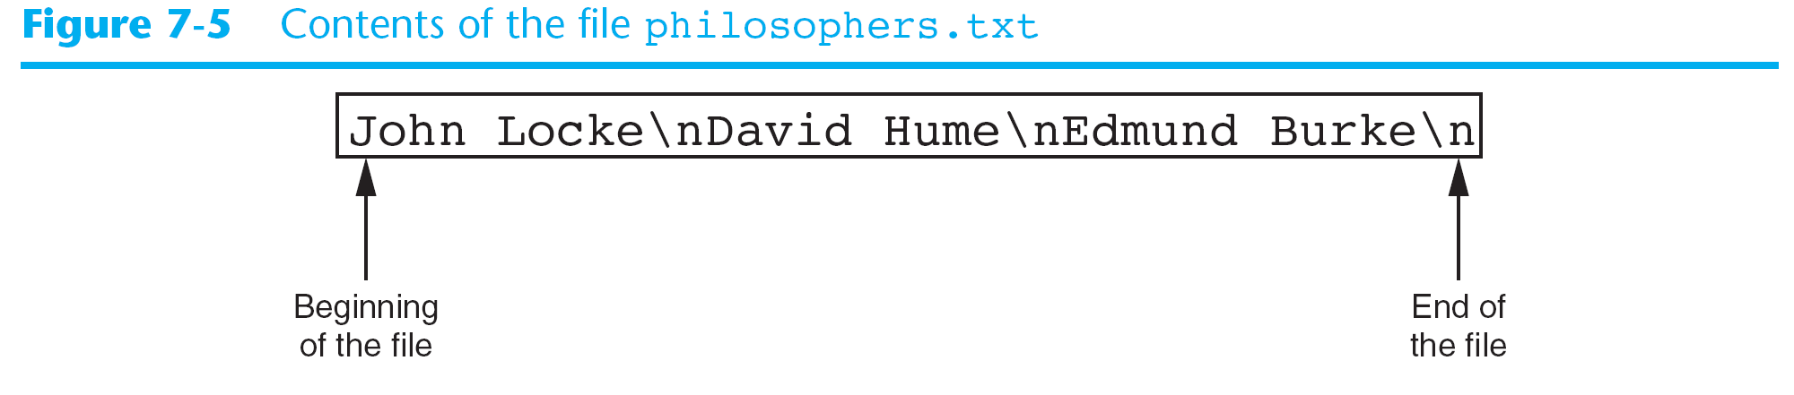
Writing Data to a File
Open file_write.py

Slide 20
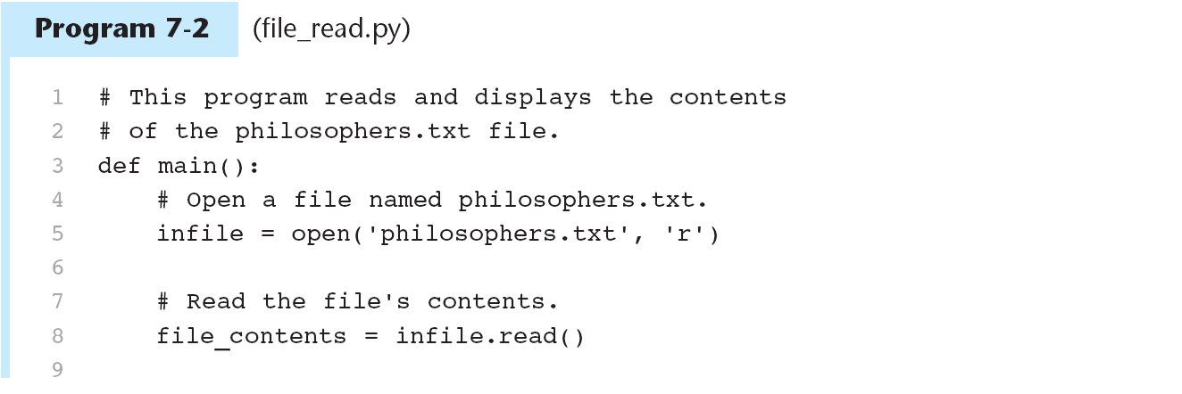
Reading Data from a File
If a File has been opened for reading using the “r” mode, you can use the file object’s read method to read the entire contents into memory
The read method returns the contents as a string

Slide 21
Reading Data From a File

Slide 22
Reading Data from a File
The above method reads the entire contents of a file. Most of the time, the contents of a file must be read one item at a time
The readline method allows reading in the file a line at a time
A line is a string of characters terminated with \n
The readline method returns the line as a string including the \n

Slide 24
Reading Data from a File
When a file is opened for reading a value called read position is maintained internally by Python
The read position marks the location of the next item to be read
Initially it is set to the beginning of the file

Slide 25
Reading Data From a File
After the first line is read and assigned to line1, the position advances to the next line (past the newline)
After the second line is read and assigned to line2, the position advances to the next line

Slide 26
Reading Data From a File
After the third read, the read position goes to the end of the file

Slide 27
Concatenating a Newline to a String
In the previous example of writing string literals to a file, each string literal ended with a \n
Normally data being written to a file would not contain a newline character and must be added before writing it to a file
This ensures that each piece of data is written to a separate line in a file

Slide 29
Reading a String and Stripping the Newline from it
The newline characters serves a purpose inside a file because it separates the items that are stored
However, often the newline serves no purpose inside a program so it can be stripped
Python has a method associated with strings that can remove or strip characters from the end of a string
rstrip removes characters from the right side of a string
name = ‘Joanne Manchester\n’
name = name.rstrip(‘\n’)

Slide 32
Appending Data to an Existing File
Using the write mode to open an output file creates a new file
Frequently it is necessary to append data to an existing file
This can be done using the append mode
Example: friends.txt contains
Joe
Rose
Sam
The following code opens and appends more names:
myfile = open(‘friends.txt’, ‘a’)
myfile.write(‘Matt\n’)
myfile.write(‘Chris\n’)
myfile.close

Slide 33
Appending Data to an Existing File
After this program runs, friends.txt will contain:
Joe
Rose
Sam
Matt
Chris

Slide 34
Writing and Reading Numeric Data
We discussed that txt files contain character data or strings
Strings can be written directly to files with the write method but numbers have to be converted to text strings
Python’s function str converts a number to a string
num1 = 32
outfile.write(str(num1) + ‘\n’)

Slide 36
Writing and Reading Numeric Data

Slide 37
Writing and Reading Numeric Data
Numbers read from a text file are read as strings
Example:
infile = open (‘numbers.txt’, ‘r’)
value = infile.readline()
infile.close()
After this executes value will contain ‘22\n’

Slide 38
Writing and Reading Numeric Data
To convert this to an integer:
infile = open (‘numbers.txt’, ‘r’)
string_input = infile.readline()
value = int(string_input)
infile.close()
Both int and float ignore the newline character
The read statement above can be replaced with one line of code
infile = open (‘numbers.txt’, ‘r’)
string_input = int(infile.readline())
infile.close()

Slide 40
Review
What three steps must be taken by a program when it uses a file?
What are the two types of files we discussed? What are the differences?
What are the modes that can be used to open a file (that we discussed today)?
What happens if you open a file in ‘w’ mode and the file already exists?
What is the purpose of opening a file?
What is the purpose of closing a file?
What is the read position? What is the initial read position?
What mode do you use to add data to a file?

Slide 41
In-Class Assignment Ch. 6 Part 1
Write a program that opens an output file with the filename my_name.txt, writes your name to the file, then someone else’s name. Then, write your age to the file. Close the file.
Open my_name.txt in notepad and view the contents.
Write a program that opens the my_name.txt file that was created by the program in problem 1, reads the names from the file, displays the names on the screen. Read your age and divide it by two. Print both age and age divided by 2 and then close the file. Don’t forget to strip off the newline character when you read in the names and convert the age to int.
Print and turn in when your programs are working correctly

Slide 42
6.2 Using Loops to Process Files
Files usually contain large amounts of data and loops are useful to process the data

Slide 43
Writing to a file using a for loop
write_sales.py
# This program prompts the user for sales amounts
# and writes those amounts to the sales.txt file.
def main():
# Get the number of days.
num_days = int(input('For how many days do ' + \
'you have sales? '))
# Open a new file named sales.txt.
sales_file = open('sales.txt', 'w')
# Get the amount of sales for each day and write
# it to the file.
for count in range(1, num_days + 1):
# Get the sales for a day.
sales = float(input('Enter the sales for day #' + \
str(count) + ': '))
# Write the sales amount to the file.
sales_file.write(str(sales) + '\n')
# Close the file.
sales_file.close()
print('Data written to sales.txt.')
# Call the main function.
main()

Slide 44
Writing to a file using a for loop
Contents of the Sales File

Slide 45
Reading a File with a Loop and Detecting End of File
In the previous example, the number of items in the file is known
Most of the time, the number of items in a file is not known
Often programs must process all of the items in a file until the read position is at the end of the file without knowing how many items are in the file
In Python, the readline method returns an empty string (‘’) when it has attempted to read beyond the end of the file

Slide 46
Reading a File with a Loop and Detecting End of File
The general looping algorithm in pseudocode:
Open the file
Use readline to read the first line from the file
While the value returned is not an empty string:
Process the item that was just read from the file
Use readline to read the next line from the file
Close the file

Slide 47
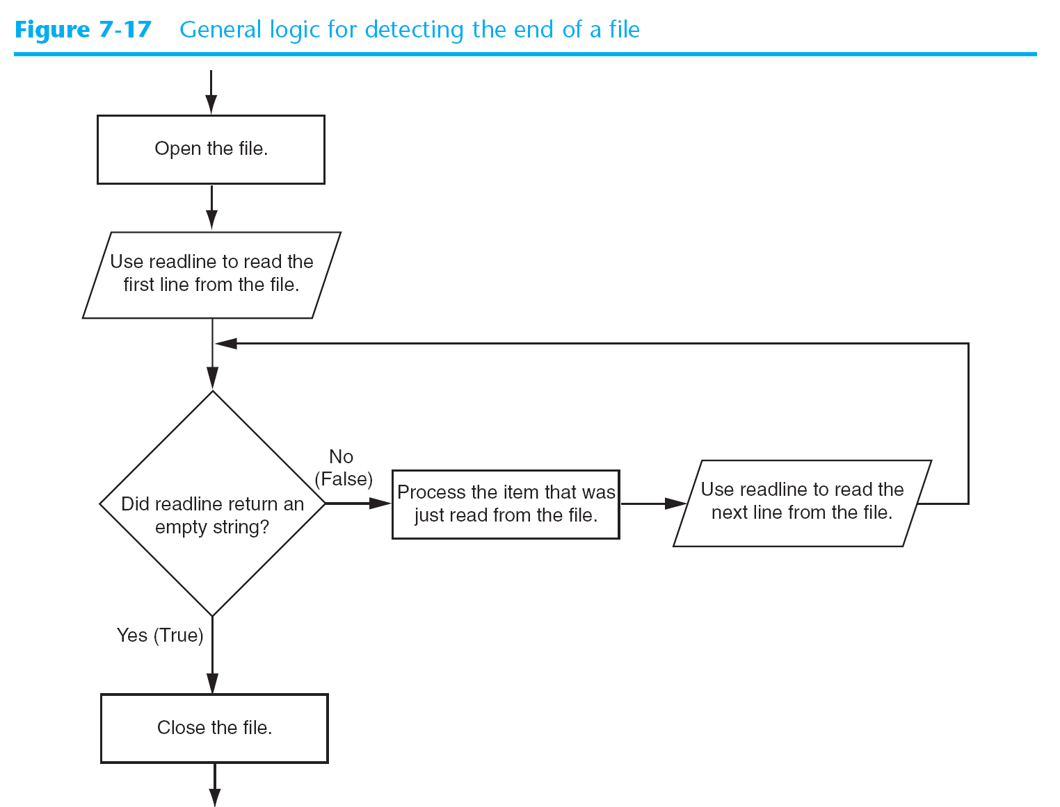
General Logic for Detecting End of File

Slide 49
Using the for Loop to Read Lines
Other programming languages have other ways of detecting end of file
Python allows the use of a for loop that is similar to ways end of file is detected in other languages
The loop does not require a priming read and automatically stops when the end of file has been reached
General format:
for variable in file_object:
Statement
Statement
Etc.
The loop will iterate once for each line in the file

Slide 50
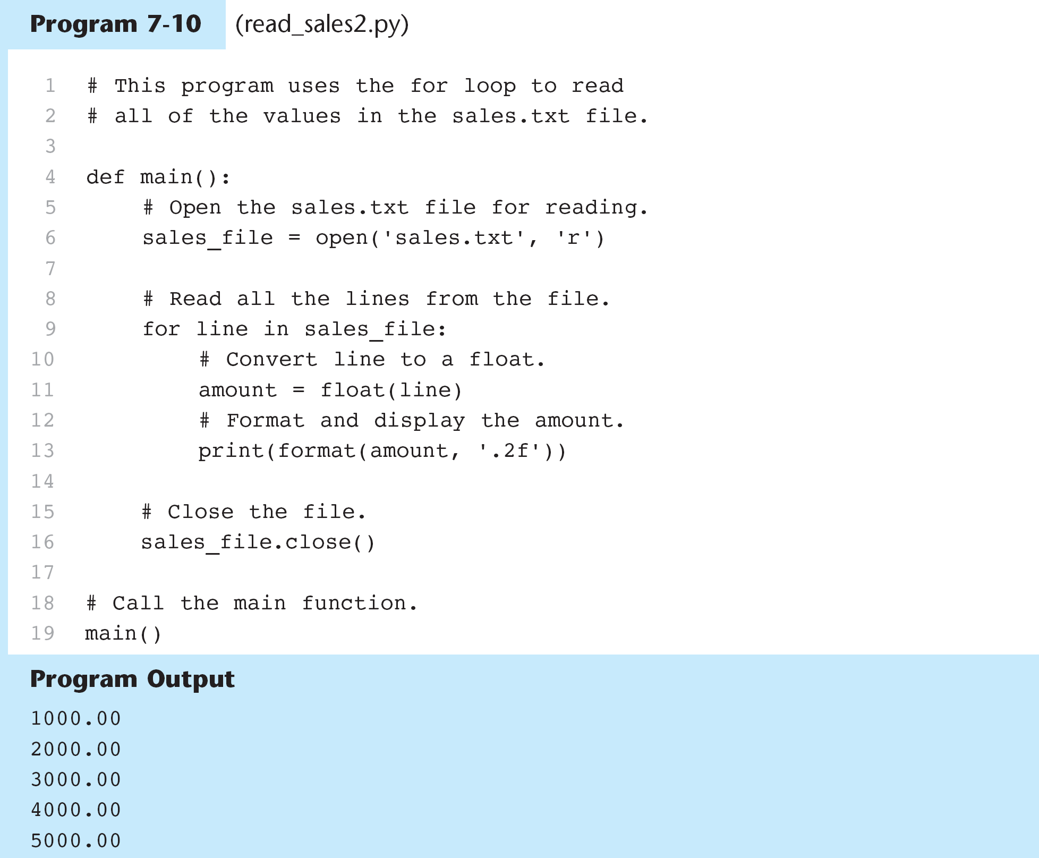
Using the for Loop to Read Lines

Slide 51
In the Spotlight: Working with Files
P. 257
save_running_times.py
read_running_times.py

Slide 52
Ch. 6 In-Class Assignment (Part 2)
1. Write code that does the following: opens an output file with the filename number_list.txt, uses a loop to write the numbers 1 through 100 to the file, and then closes the file. Be sure to write your file to your H: drive to use in the next assignment
2. Write code that opens the file you just created, reads all the numbers from the file, displays them, accumulates a total and then closes the file. Display the total. Terminate the loop by detecting end of file with a for loop (the second method we discussed).
Print the programs and turn them in

Slide 53
6.3 Processing Records
Data organized in files is often stored as “sets” or groups of data called records
Records are complete sets of data that contain fields which is a single piece of data
See Save employee_records
Fields in a Record

Slide 54
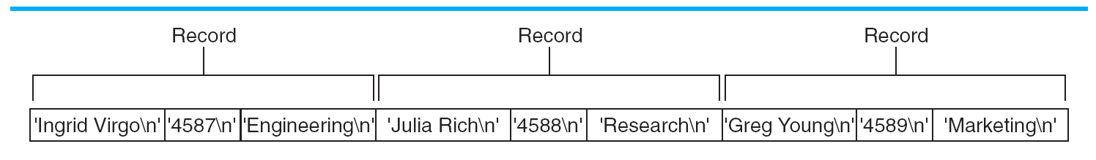
6.3 Processing Records
Each time you write a record to a sequential access file you write fields that make up the record, one after another
Records in a File
# Write the data as a record to the file.
emp_file.write(name + '\n')
emp_file.write(id_num + '\n')
emp_file.write(dept + '\n')

Slide 55
6.3 Processing Records
When data is read from a sequential access file it is read one field at a time until the complete record is read
Open read_emp_records.py

Slide 56
Adding Records
Often, more capabilities are required than just reading from or writing to a file. It is also necessary to add records to a file, search for specific records, modify records, and delete records.
p. 263 Midnight Coffee Roasters – program to track inventory of coffee. Each record has two fields:
Description – string containing the coffee name
Quantity in inventory – in pounds, floating point
Program to add records to an existing file – add_coffee_record.py (uses coffee.txt)
Program to display records – show_coffee_records.py

Slide 57
Searching for a Record
Midnight Coffee Roasters need another program to search for specific records. They want to search by description and see all records matching that description
Open search_coffee_records using coffee.txt

Slide 58
Modifying Records
The next program that Midnight Roasters wants is to change the quantity field in an existing record
To modify an existing file, a temporary second file must be created
All of the original files records are copied to the second file, but when you get to the one to be changed, it is modified before it is written
The all the remaining records are written to the file

Slide 59
Modifying Records
General algorithm:
Open the original file for input and create a temporary file for output
Get the description of the record to be modified and the new value for the quantity
Read the first description field from the original file
While the description field is not empty:
Read the quantity field
If this record’s description field matches the description entered:
Write the new data to the temporary file
Else:
Write the existing record to the temporary file
Read the next description field
Close the original file and the temporary file
Delete the original file
Rename the temporary file, giving it the name of the original file
Open modify_coffee.records.py

Slide 60
6.4 Exceptions
An exception is an error that occurs while a program is running causing the program to abruptly halt. The try/except statement in Python allows graceful handling of exceptions
There are situations in a program that can be potential sources of exceptions such as dividing by zero
Open division.py
Open division2.py

Slide 61
6.4 Exceptions
Exceptions can occur because the user enters invalid data
Python allows writing code that responds to exceptions when they are raised and prevents the program from abruptly crashing. This is called an exception handler and is written with the try/except statement
General format is:
try:
statement
statement
except ExceptionName:
statement
statement
Open gross_pay1.py and gross_pay2.py
The try suite
The exception clause - handler

Slide 62
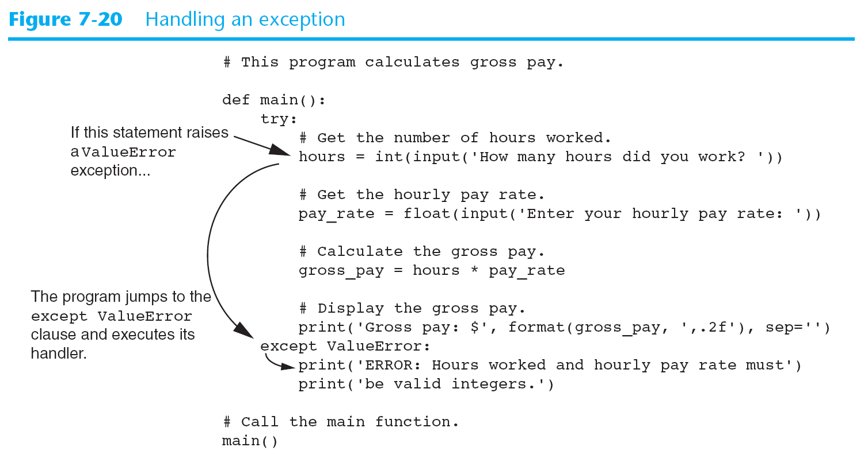
6.4 Exceptions
Handling Exceptions

Slide 63
Handling Multiple Exceptions
In many cases your program may encounter multiple types of exceptions
You would write an except clause for each type of exception
For Example:
An IOError can occur if the file doesn’t exist
A ValueError can occur if an attempt is made to convert a string to a float
The program can also have a message to handle errors of unspecified types
See sales_report1.py

Slide 64
Using One Except Clause
The previous example showed different exceptions based on the type of error.
You can also create a try/except statement that catches any exception that occurs.
The disadvantage is that it does not specify the exception type
See sales_report2.py

Slide 65
sales.report2.py
# This program displays the total of the
# amounts in the sales_data.txt file.
def main():
# Initialize an accumulator.
total = 0.0
try:
# Open the sales_data.txt file.
infile = open('sales_data.txt', 'r')
# Read the values from the file and
# accumulate them.
for line in infile:
amount = float(line)
total += amount
# Close the file.
infile.close()
# Print the total.
print(format(total, ',.2f'))
except:
print('An error occurred.')
# Call the main function.
main()

Slide 66
Displaying an Exception’s Default Error Message
When an exception is thrown an exception object is created in memory which contains a message related to an error
Format:
except ValueError as err:
print(err)
This will save the message in the variable err (our choice)
This variable can be printed for a more customized message
See gross_pay3, sales_report3

Slide 67
sales.report3.py
# This program displays the total of the
# amounts in the sales_data.txt file.
def main():
# Initialize an accumulator.
total = 0.0
try:
# Open the sales_data.txt file.
infile = open('sales_data.txt', 'r')
# Read the values from the file and
# accumulate them.
for line in infile:
amount = float(line)
total += amount
# Close the file.
infile.close()
# Print the total.
print(format(total, ',.2f'))
except Exception as err:
print(err)
# Call the main function.
main()

Slide 68
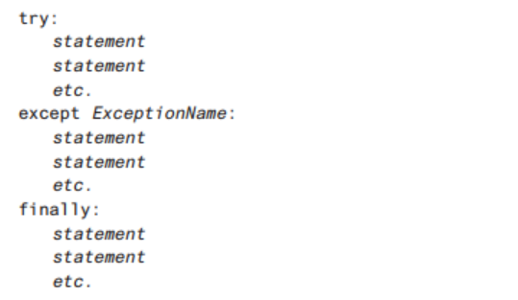
The finally clause
try/except suites can contain an optional finally clause which allows for post exception cleanup such as closing files or other resources.
Any code that is in the finally clause will execute regardless of whether an exception was thrown in the try/except:
The format is:

Slide 69
Ch. 6 In Class Assignment Part 3
Write a program that uses the file you created last time called number_list.txt
Your program should read in number_list.txt and calculate the sum and average of all the numbers and display the sum and the average.
Additionally, it should:
Handle any IOError exceptions that are raised when the file is opened and data is read from it
Handle any ValueError exceptions that are raised when the items read are converted to numbers
Handle any other unspecified errors

